Slide 1
Data Management for Dynamic Multimedia Analytics and Retrieval
PhD Defense
Ralph Gasser<ralph.gasser@unibas.ch> Databases and Information Systems (DBIS) Group, Department of Mathematics and Computer Science, University of Basel
Basel, 28 November 2022

Slide 2













Motivation: Ubiquitous Multimedia
Multimedia Retrieval
Social Media Analysis
Medical Signal Analysis
Storing Large Data Collections
Images, Videos, Audio, 3D
Low-frequency changes
Finding Items
“Needle in the haystack”
Short-running queries
Collecting Data Over Time
Text, Images, Videos etc.
High-frequency changes
Performing Analysis
Trends, Tendencies, Interest
Short and long-running queries
Collecting Data Over Time
Abstract signal data
Little to no changes
Analysing Data
Potentially long-running query
Highly optimised appliction

Slide 3



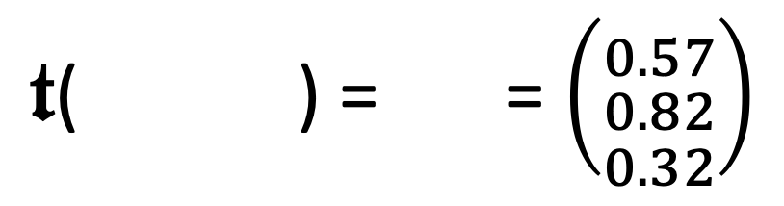
Properties of Multimedia Data
Multimedia data is often unstructured (raw signal data)
→ Disconnect between data one stores and information one searches → Derivative representations required
We make multimedia data accessible by metadata
→ Technical metadata (e.g., resolution) → Textual descriptions / labels / annotations
→ Abstract features
Different types of metadata can be searched differently
→ Boolean retrieval (exact matches)
→ Similarity search / vector space retrieval (fuzzy)
”grass”
”rabbit”
”bunny”
”Nutello”
$𝖙$( ) = = $\left({0.57 \atop \begin{aligned}0.82 \\ 0.32\end{aligned}}\right)$
Feature transformation
$$𝕆→ 𝔽$$

Slide 4
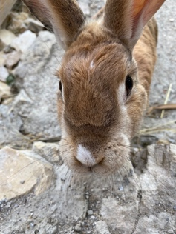
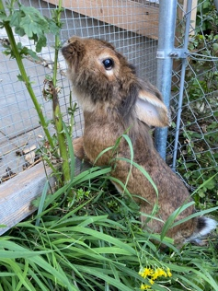
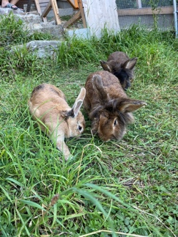
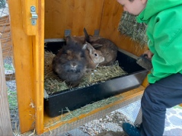
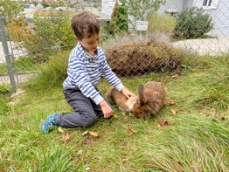


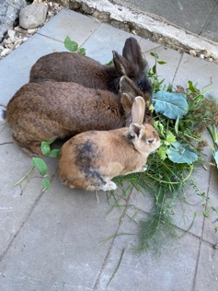

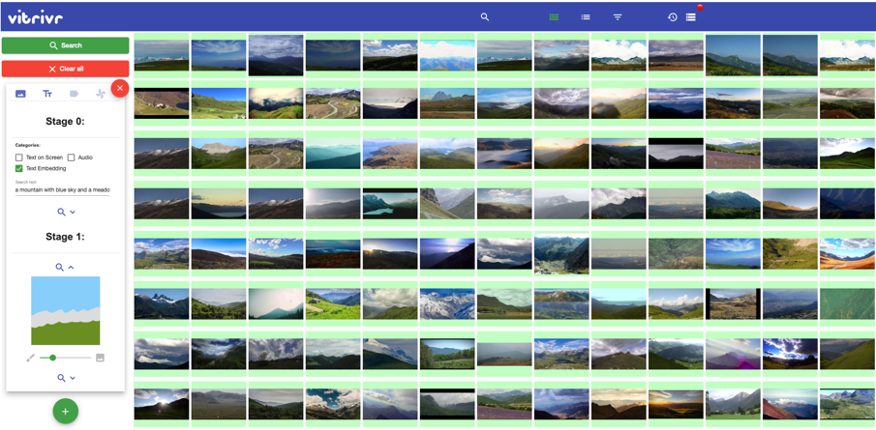
State of the Art in Multimedia Retrieval
Retrieval System
Feature Extraction Indexing
Storage
Data Storage
Scalar data
Feature vectors
Index structures
Metadata
Collection
offline
Multimedia Database
online
User Query
Query Interpretation Orchestration
Database Query
Query Execution
Boolean search (exact)
Similarity search (fuzzy)
Short vs. long-running
User Interface
Results
Results Fusion
Results
Rossetto et al. (2014). Cineast: a multi-feature sketch-based video retrieval engine.

Slide 5
What about more Complex Applications?

Slide 6


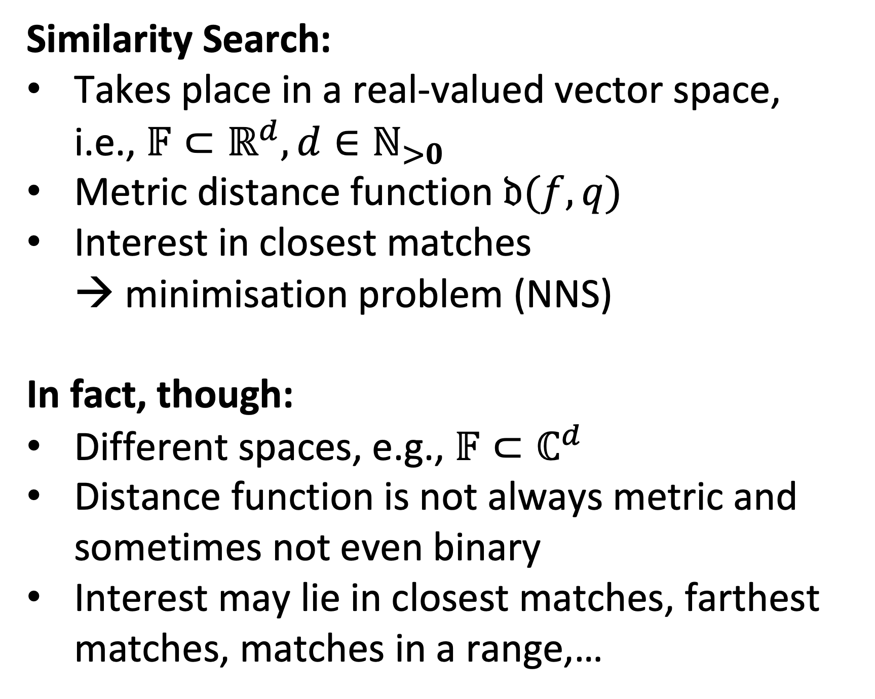

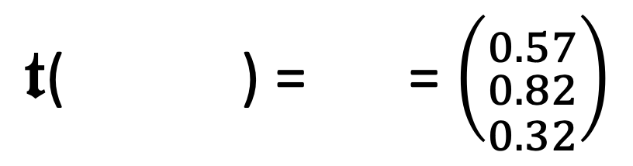
Challenging the Status Quo: Assumption 1
$𝖙$( ) = = $\left({0.57 \atop \begin{aligned}0.82 \\ 0.32\end{aligned}}\right)$
Similarity Search:
Takes place in a real-valued vector space, i.e., $𝔽⊂ℝ^{d}, d∈ℕ_{>0}$
Metric distance function $𝔡(f,q)$
Interest in closest matches → minimisation problem (NNS)
In fact, though:
Different spaces, e.g., $𝔽⊂ℂ^{d}$
Distance function is not always metric and sometimes not even binary
Interest may lie in closest matches, farthest matches, matches in a range,…
green
Feature transformation
$$𝕆→ 𝔽$$
$$𝔡$$
Query
red
High-dimensional Vector Space $$𝔽⊂ℝ^{3}$$
blue
Salton et al. (1975). A Vector Space Model for Automatic Indexing.

Slide 7
Challenging the Status Quo: Assumption 2
Data collections do not change
Offline vs. online phase (indexing vs. search)
Index structures can be prepared
No concurrent access to data
In fact, though:
Data may be subject to change (e.g., CRUD, social media analysis)
Write and reads to multimedia database may take place concurrently
Index structures must be able to cope with (concurrent) changes
Retrieval System
Feature transformation Indexing
Storage
offline
Multimedia Database
online
Query
Query Interpretation
Score Fusion Orchestration
Rossetto et al. (2014). Cineast: a multi-feature sketch-based video retrieval engine.

Slide 8
Challenging the Status Quo: Assumption 3
Database User drives execution behaviour:
Simple, pre-determined workloads
Only a matter of “parametrisation” (e.g., query vector)
End-user has system-level knowledge
In fact, though:
Query workloads are very varied (see exploration search axis)
Execution paths impact results (execution time, retrieval quality)
Workloads allow for different trade-offs
User may not be an expert

Slide 9
Contributions
Vision: “Bring about convergence between research done in multimedia retrieval and analytics on the one hand and databases on the other hand to design the blueprints for a database management system (DBMS) for multimedia data that can cope with the broad range of requirements that multimedia retrieval and multimedia analytics bring.”
Conceptual
A model for proximity based queries as an extensions of the relational data model with the aim to maintain the composability of the relational model to allow for query execution planning.
A cost model for query planning that takes the expected and desired quality of results into account, in addition to traditional metrics (e.g., IO or CPU cost)
A model for the maintenance of high-dimensional index structures in the face of dynamic data.
Implementation
A reference implementation using the aforementioned models in the form of Cottontail DB
An evaluation showing the effectiveness of both model and implementations

Slide 10
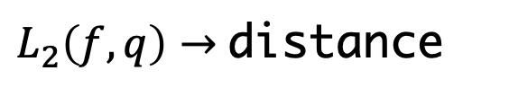
A Relational Model to Accommodate Proximity Based Queries
Sketch:
Proximity-based Queries (NNS, FNS, Range-search etc.) are enabled by functions (e.g. Euclidean distance)
Function evaluation is integrated into relational algebra (relational extension)
Functions themselves are first-class citizens of the DBMS and allow for optimization
select id, L2(feature, [0.0,0.0,0.0]) as distance from paintings order by distance asc limit 100
Scan
paintings
Function
$L_{2}\left(f,q\right)→$distance
kNN / NNS
Order
distance ASC
Limit
100
Project
id,distance

Slide 11
A Relational Model to Accommodate Proximity Based Queries Planning and Optimising the Query
Class 1 Index Replacement
Scan[VAF]
Project
Scan
Scan
Function
Function
Optimised Order & Limit
kNN / NNS
Order
Limiting+Order
Limit
Project
Scan[PQ]
Project
Class 3 Index Replacement
Order
Limit
Project

Slide 12
A Cost Model for Results Quality

Slide 13
High-Dimensional Index Maintainance

Slide 14
Putting Everything Together

Slide 15
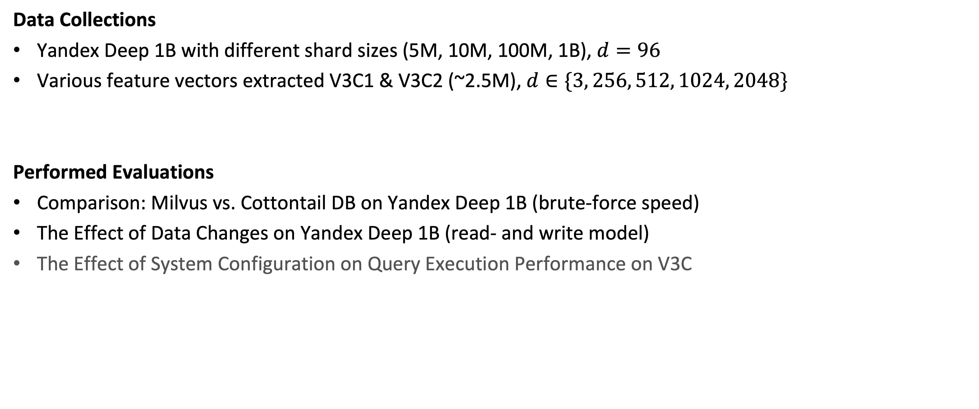
Evaluation: Setup
Data Collections
Yandex Deep 1B with different shard sizes (5M, 10M, 100M, 1B), $d=96$
Various feature vectors extracted V3C1 & V3C2 (~2.5M), $d∈\{3, 256, 512, 1024, 2048\}$
Performed Evaluations
Comparison: Milvus vs. Cottontail DB on Yandex Deep 1B (brute-force speed)
The Effect of Data Changes on Yandex Deep 1B (read- and write model)
The Effect of System Configuration on Query Execution Performance on V3C

Slide 16
Evaluation: The Effect of Query Execution Planning

Slide 17
Evaluation: The Effect of Query Execution Planning - Discussion

Slide 18
Evaluation: The Effect of Changing Data

Slide 19
Evaluation: The Effect of Changing Data - Discussion

Slide 20
Conclusion

Slide 21
Future Work

Slide 22

Thank you!
Questions?
Ralph Gasser
ralph.gasser@unibas.ch
Databases and Information Systems (DBIS) Group, Department of Mathematics and Computer Science, University of Basel

Slide 23
Backup Slides

Slide 24



Motivation: Working with Multimedia Data Collections (Idealised Case)
Query
Result
“I’m looking for an image of my favourite rabbit.”
User
Multimedia Database
Data Collection

Slide 25



Motivation: Working with Multimedia Data Collections (Actual Case)
Query by Sketch
Query
Result
“I’m looking for an image of my favourite rabbit.”
…
User
Multimedia Database
Data Collection
Exploration

Slide 26

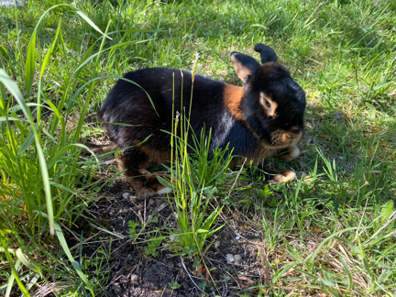
Motivation: Working with Multimedia Data Collections (Actual Case)
Query by Example
Query
Result
“I’m looking for an image of my favourite rabbit.”
…
User
Multimedia Database
Data Collection

Slide 27
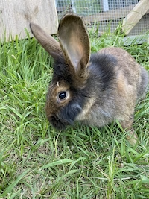




Motivation: Working with Multimedia Data Collections (Actual Case)
Query by Example
Query
Result
“I’m looking for an image of my favourite rabbit.”
…
User
Multimedia Database
Data Collection

